Slide 1
TITLE- Persistent diplopia after repair of orbital blowout fracture
PRESENTING AUTHOR
Dr. Reena Gupta
Professor, RIO
Paediatric ophthalmologist &Strabismologist
PGIMS, Rohtak
CO- AUTHORS- Dr Neebha Anand, Dr Rohan Madan, Dr Akanksha Yadav

Slide 2
INTRODUCTION
Orbital trauma accounts for 36.3% of all facial fracture presentations. Strabismus occurs in 58% of patients with Blow out fractures¹ .
Orbital fractures are common sequelae of blunt trauma to the periocular region. Diplopia after orbital-floor fracture is not rare and is commonly attributed to incarceration of an extraocular muscle in the fracture site.
In cases of vertical diplopia, traumatic inferior rectus muscle (IR) rupture is a rare, but possible cause of persistent infraduction deficit after repair of blow-out fracture which can be managed conservatively.
Few cases have been published in the literature. We describe such an uncommon case with a review of the relevant published literature.
Tomasetti P,Metzler P, Jacobsen C.Isolated inferior rectus muscle rupture after blunt orbital trauma.JSCR 2013;9(3):107-9

Slide 3
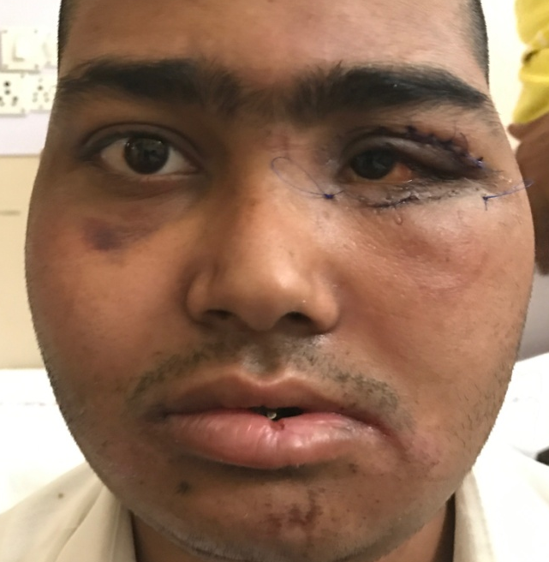
CASE REPORT
17 year old boy was referred to strabismus clinic with complaint of-
persistent double vision
mild enophthalmos in left eye post surgical repair of orbital floor fracture by maxillofacial surgeon
PAST HISTORY
2 weeks before reporting to us patient presented in trauma center after he met with road traffic accident with C/O
loss of consciousness,
Oronasal bleeding,
Nausea, vomiting, headache
Pain in left eye and double vision
Referred to maxillofacial surgeon from emergency
Fig 1-showing enophthalmos and sutured wounds 10 days post surgical repair

Slide 4
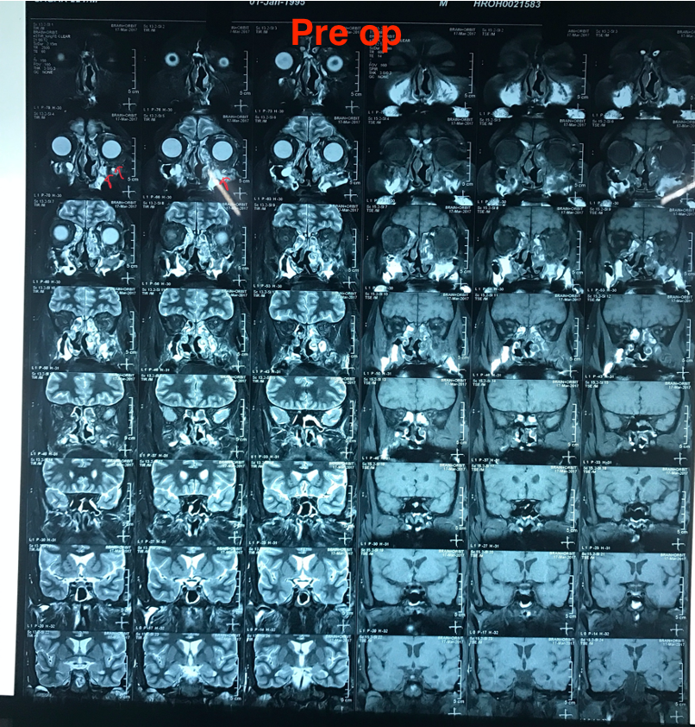
EXAMINATION BEFORE REPAIR
EXAMINATION DOCUMENTED ON RECORDS
Left periorbital swelling
Significant subconjunctival haemorrhage
Significant Enophthalmos present(>2mm)
Tenderness to palpation over inferior orbital rim
Presence of infraorbital hypoesthesia
Limitation of ocular motility
Force duction test –(Positive) Restriction in vertical upward direction, suggesting entrapment of IR muscle.
Fig-2 CT scan showed presence of large fracture of the floor of the left orbit (red annotations with herniation of the orbital fat and contents into maxillary sinus

Slide 5
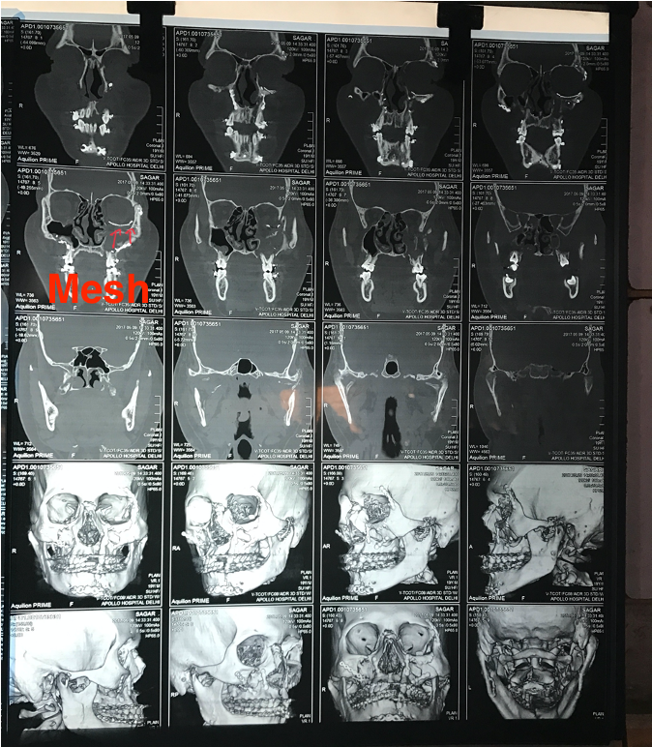
Diagnosis- Fracture of floor of orbit with entrapment of Inferior rectus muscle in left eye
Treatment- Surgical reduction of entraped inferior rectus muscle and orbital tissues with repair of orbital floor fracture using titanium mesh under General anaesthesia
Fig-3 CT Scan 3D Face shows comminuted fracture of walls of maxillary sinuses.Metallic mesh in floor of left orbit. Multiple metallic fixator seen over maxillary sinus wall

Slide 6
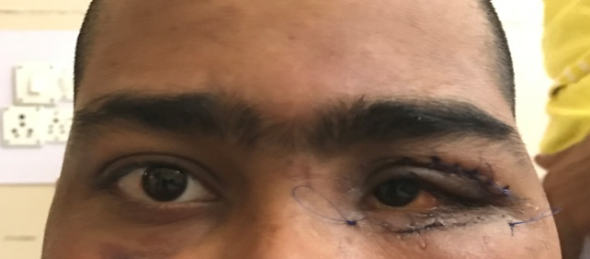
WHY WAS HE REFERRED TO STRABISMUS CLINIC POST SURGICAL REPAIR
Persistent vertical diplopia with ocular deviation and limitation of ocular motility post surgical repair
OCULAR EXAMINATION
VA- 6/6 R/E 6/9 L/E
Mild periorbital swelling
subconjunctival haemorrhage
Mild enophthalmos was present (2mm)
Sutured wound over upper and lower lid
DIPLOPIA CHARTING 1M-
Vertical diplopia in primary position and downgaze
increasing in laevodepression
Fig 4- mild enophthalmos
Fig-5 Diplopia charting at 1 m

Slide 7
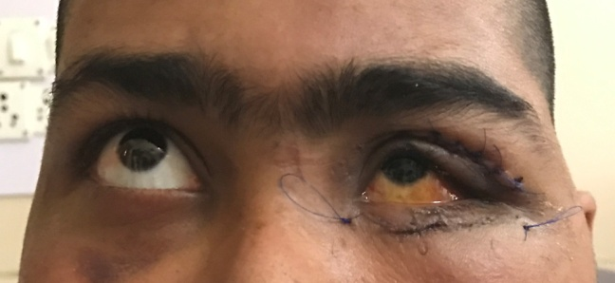

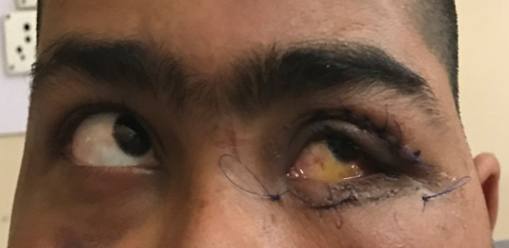
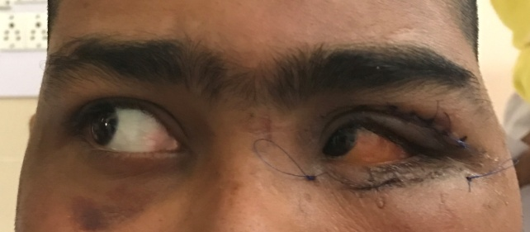
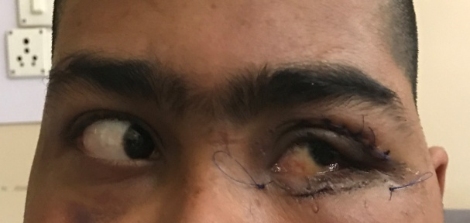
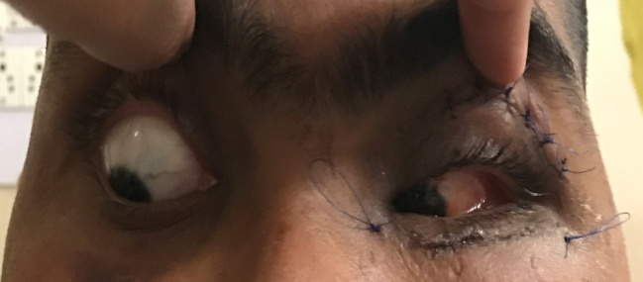
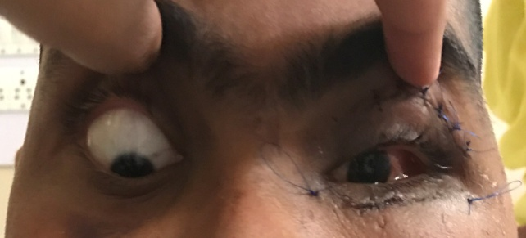
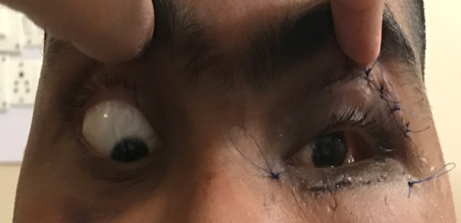
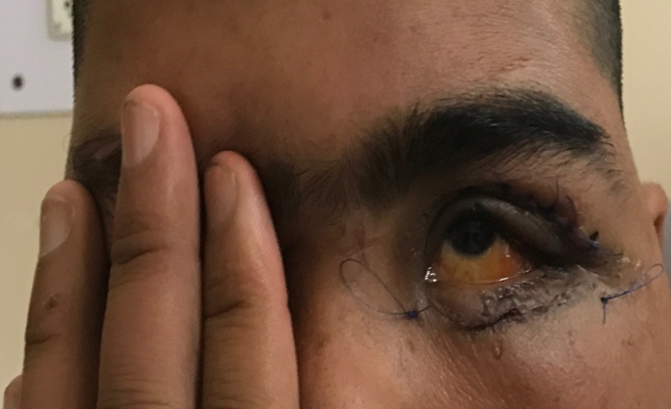
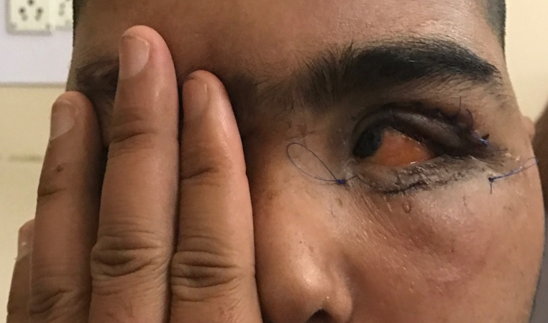
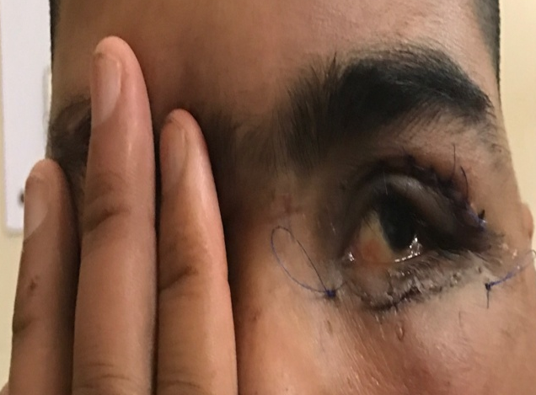
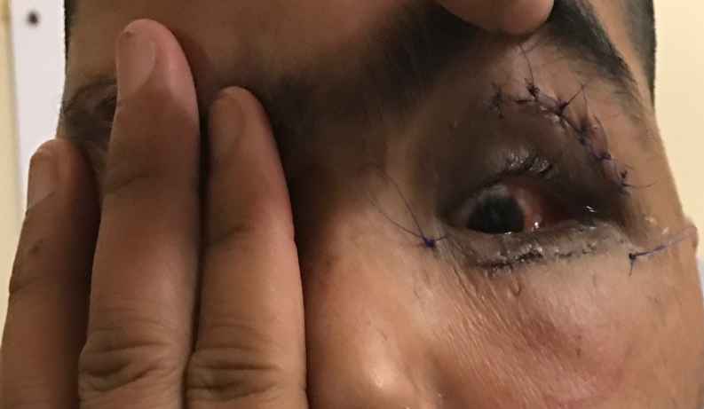
OCULAR MOTILITY EXAMINATION
VERSIONS- Fig-6 Left eye exhibits -1 limitation in upward gaze and -2 .5 limitation in downward gaze
DUCTIONS Fig-7 -2 infraduction limitation in left eye

Slide 8
Ortho
Ortho
16L/R
20L/R 8BI
22L/R 7BI
24L/R
Near-10L/R
Distance- 16 L/R
Fig-8 Measurement of ocular deviation in diagnostic positions of gaze shows-Hypertropia in primary position and increasing in downgaze
Force Duction Test – Negative
Force Generation test-Weak force generation test as some resistance was felt
Saccades- Downward slowed saccades

Slide 9
What are we dealing with?
INTRAORBITAL OEDEMA | ENTRAPMENT OF IR MUSCLE (RESTRICTION OF IR) | FLAP TEAR OF MUSCLE (PARESIS OF IR) | RUPTURE OF IR MUSCLE (COMPLETE PALSY OF IR) | POSTERIOR BLOW OUT FRACTURE (COMBINED RESTRICTIVE AND PARETIC)
MILD NONSPECIFIC LIMITATION OF MOTILITY | LIMITATION IN SUPRADUCTION | LIMITATION IN DEPRESSION | NO MOVEMENT IN DOWNGAZE BEYOND MIDLINE | LIMITATION IN DEPRESSION AND ELEVATION I
FDT MILD RESTRICTION | FDT- POSITIVE | FDT -NEGATIVE | FDT-NEGATIVE | FDT- POSITIVE IN UPGAZE
 | FGT-NORMAL | FGT- WEAK | FGT- ABSENT | FGT-WEAK FOR IR
NO DEVIATION | HYPOTROPIA | HYPERTROPIA | LARGE ANGLE HYPERTROPIA | ANY DEVIATION HYPO IN UPGAZE (RESTRICTIVE) HYPER IN DOWNGAZE(PARETIC)
NORMAL SACCADES | NORMAL UPWARD | SLOWED DOWNWARD | SLOWED DOWNWARD | NORMAL UPWARD

Slide 10
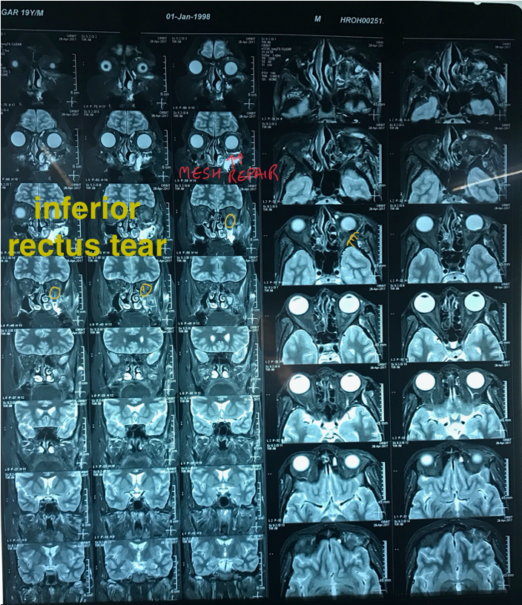
RE-EVALUATION OF MRI SCAN
DIAGNOSIS-
Persistent diplopia post partial tear of inferior rectus muscle-iatrogenic/ finding missed during repair of orbital floor fracture
TREATMENT :
Conservative
He was able to fuse with 12 PD in primary position
Prescribed 6PD BU in right eye
6PD BD in left eye
in spectacles, separate pair for near
Fig-9 MRI 2mm Coronal cuts taken post repair of orbital floor fracture revealed a partial tear of the inferior rectus(yellow annotations)

Slide 11
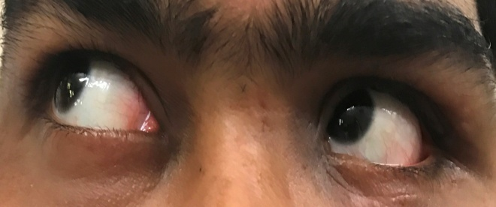
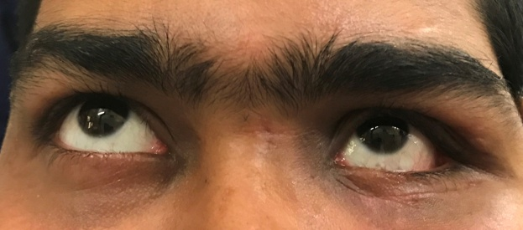
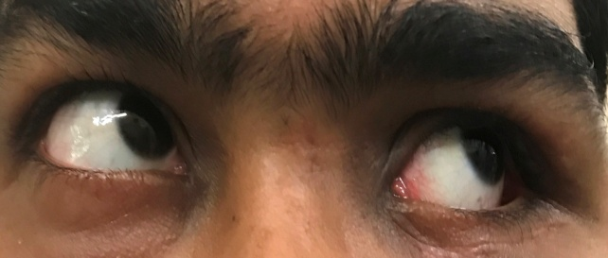
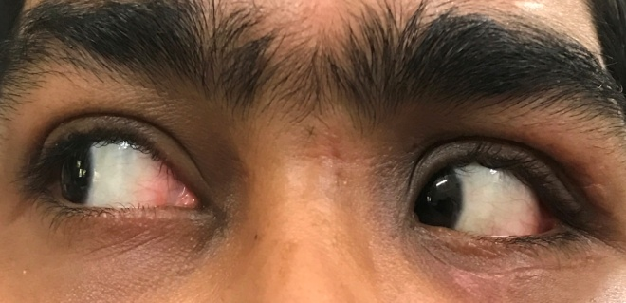
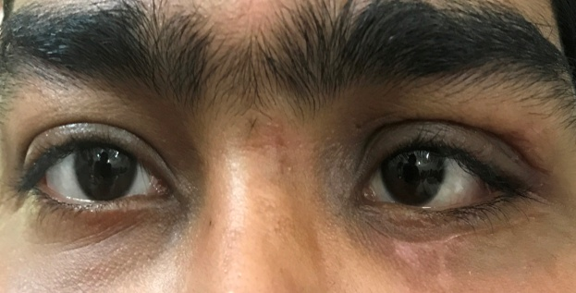
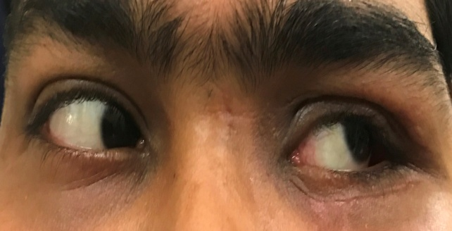
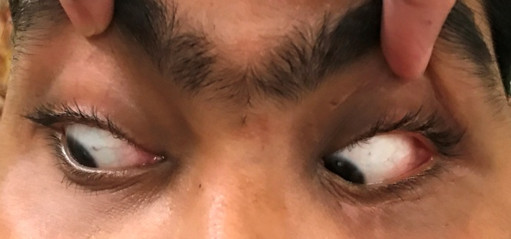
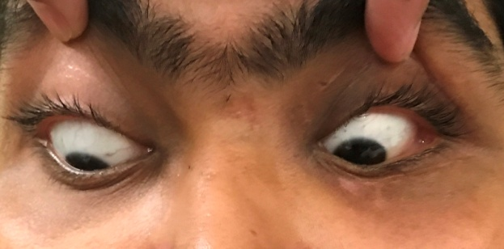
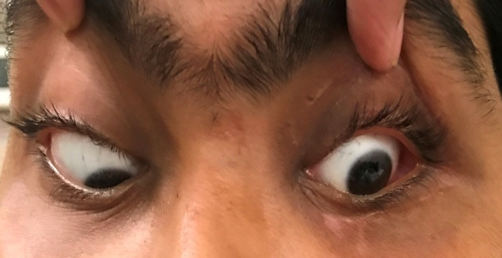
Ortho
Ortho
Ortho
14 L/R with 8 BI
10 L/R with 7 BI
Fig-10 shows improvement in deviation and motility after con servative management
Satisfactory functional recovery after 3months and 6 months of follow up without need of surgery for strabismus
Stable alignment
Improvement in Enophthalmos
Hypertropia only in downgaze-patient refused surgery for residual deviation
-1 limitation in infraduction
No diplopia in primary position

Slide 12
To conclude
VERTICAL DIPLOPIA POST ORBITAL TRAUMA
ENTRAPMENT
OCC
>50%FRACTURE
ENOPHTHALMOS
PERSISTENT DIPLOPIA
RESTRICTION IR
HYPOTROPIA-IR recession
IR PARESIS-
HYPER –<10-observe/IR res
>10- SR rec ADD
Faden with IR rec C/L
RESTRICTIVE + PARESIS

